Slide 1

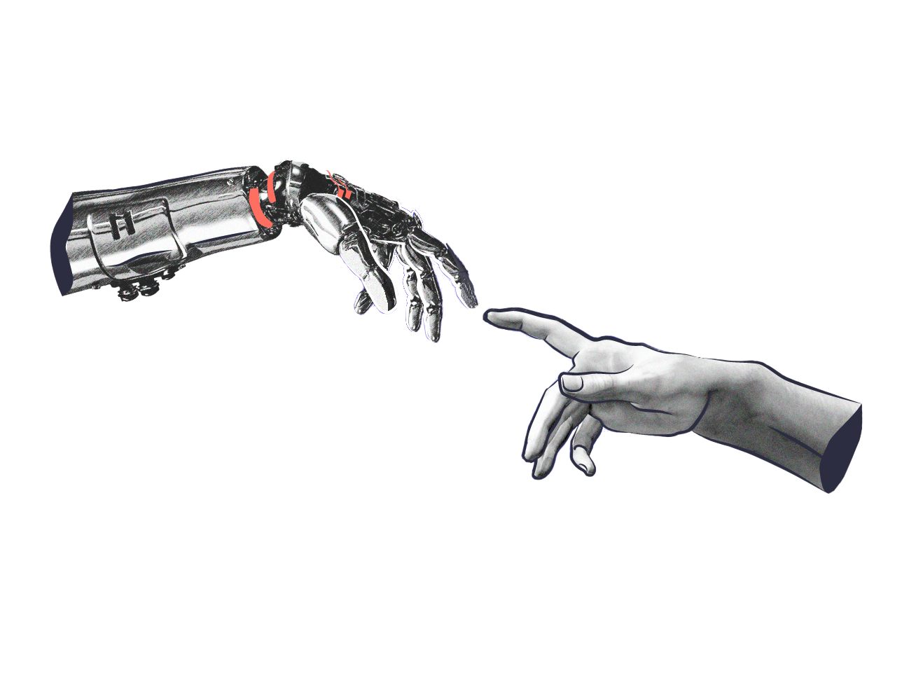
Human - Computer
Interaction
Present by Chi Nguyen

Slide 2
CONTENTS
The human
The computer
The interaction
Paradigms

Slide 3
Why study paradigms
Concerns
How can an interactive system be developed to ensure its usability?
How can the usability of an interactive System be demonstrated or measured?
History of interactive system design provides paradigms for usable designs

Slide 4
What are paradigms
Predominant theoretical frameworks or scientific world views - ex: Aristotelian, Newtonian, Einsteinian (relativistic) paradigms in physics
Understanding HCI history is largely about understanding a series of paradigm shifts
Not all listed here are necessarily “paradigm” shifts, but are at least candidates
History will judge which are true shifts.

Slide 5
Paradigms of interaction
New computing technologies arrive, creating a new perception of the human-computer relationship.
We can trace some of these shifts in the history of interactive technologies.

Slide 6
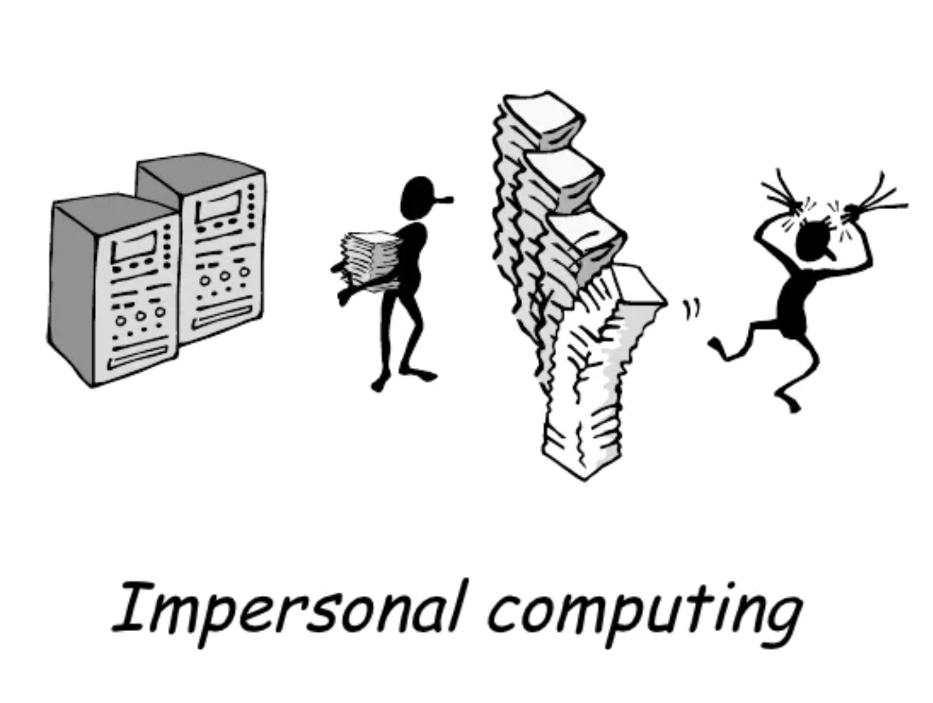
The initial paradigm
Batch processing
Time-sharing
Networking
Graphical displays
Microprocessor
WWW
Ubiquitous Computing
Notes:
A symbiosis of physical and electronic worlds in services of everyday activities

Slide 7
Time-sharing
1940s and 1950s Explosive technological growth
1960s Need to channel the power
J.C.R. Licklider at ARPA
Single computer supporting multiple users

Slide 8
Video Display Units
More suitable medium than paper
1962 - Sutherland’s Sketchpad
Computers for visualizing and manipulating data
One person’s contribution could drastically change the history of computing

Slide 9
Programming toolkit
Engelbart at Stanford Research Institute
1963 - augmenting man’s intellect
1968 NLS/Augment system demonstration
The right programming toolkit provides building blocks to producing complex interactive systems

Slide 10
Personal computing
1970s - Papert’s LOGO language for simple graphics programming by children
A system is more powerful as it becomes easier to user
Future of computing is small, powerful machines dedicated to the individual
Kay at Xerox PARC - The Dynabook as the ultimate personal computer.

Slide 11
Window systems and the WIMP interface
Engelbart at Stanford Research Institute
1963 - augmenting man’s intellect
1968 NLS/Augment system demonstration
The right programming toolkit provides building blocks to producing complex interactive systems

Slide 12
Metaphor
Relating computing to other real-world activity is effective teaching technique
LOGO’s turtle dragging its tail
File management on an office desktop
Word processing as typing
Financial analysis on spreadsheets
Vitual reality - user inside the metaphor
Problems
Some tasks do not fit into a given metaphor
Cultural bias

Slide 13
Direct manipulation
1982 - Shneiderman describes appeal of graphically-based interaction
Visibility of objects
Incremental encourages exploration
Syntactic correctness of all actions
Replace language with action
1984 - Apple Macintosh
The model-world metaphor
What You See Is What You Get (WYSIWYG)

Slide 14
Language vs Action
Actions don’t always speak louder than words!
DM - Interface replaces underlying system
Language paradigm
Interface as mediator
Interface acts as intelligent agent
Programming by example is both action and language

Slide 15
Hypertext
1945 - Vannervar Bush and the memex
Key to success in managing explosion of information
Mid 1960s - Nelson describes hypertext as non-linear browsing structure
Hypermedia and multimedia
Nelson’s Xanadu project still a dream today

Slide 16
Multimodality
A mode is a human communication channel
Emphasis on simultaneous use of multiple channels for input and output.

Slide 17
Computer Supported Cooperative Work (CSCW)
CSCW removes bias of single user/ single computer system
Can no longer neglect the social aspects
Electronic mail is most prominent success

Slide 18
The World Wide Web
Hypertext, as originally realized, was a closed system
Simple, universal protocols (ex: HTTP) and mark-up languages (ex: HTML) made publishing and accessing easy
Critical mass of user lead to a complete transformation of our information economy.

Slide 19
Agent-based Interfaces
Original interfaces
Commands given to computer
Language-based
Direct Manipulation/WIMP
Commands performed on “world” representation
Action based
Agents - return to language bu instilling proactivity and “intellignece” in command processor
Avatars, natural languague processing

Slide 20
Ubiquitous Computing
Mark Weiser, 1991
“The most profound techbologies are those that disappear”
Notes:
Mark D. Weiser (July 23, 1952 – April 27, 1999) was a computer scientist and chief technology officer (CTO) at Xerox PARC.^{[1]} Weiser is widely considered to be the father of ubiquitous computing, a term he coined in 1988.^{[1]} Within Silicon Valley, Weiser was broadly viewed as a visionary and computer pioneer, and his ideas have influenced many of the world's leading computer scientists.

Slide 21
Ubiquitous Computing
Late 1980’s: Computer was very apparent
How to make it disappear?
Shrink and embed/ distribute it in the physical world
Design interaction that don’t demand our intention
Notes:
Mark D. Weiser (July 23, 1952 – April 27, 1999) was a computer scientist and chief technology officer (CTO) at Xerox PARC.^{[1]} Weiser is widely considered to be the father of ubiquitous computing, a term he coined in 1988.^{[1]} Within Silicon Valley, Weiser was broadly viewed as a visionary and computer pioneer, and his ideas have influenced many of the world's leading computer scientists.

Slide 22
Sensor-based and Context-aware interaction
Human are good at recognizing the “context” of a situation and reacting appropriately
Automatically sensing physical phenomena (ex: light, temp, location, identity…) becoming easier
How can we go from sensed physical measures to interactions that behave as if made “aware” of the surroundings?

Slide 23
Extra
+
Some bonus for you

Slide 24
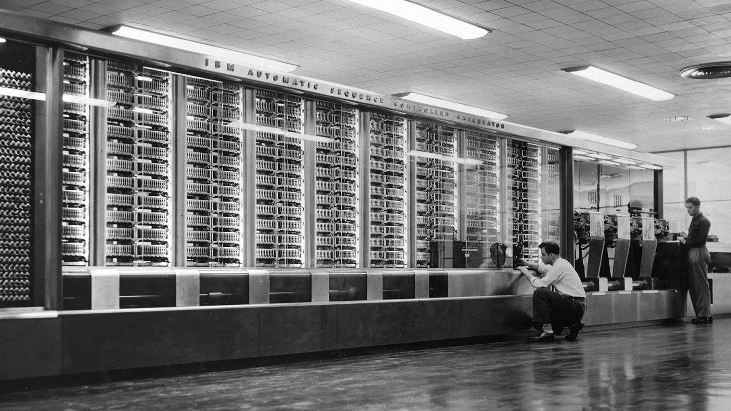
Beginning - Computing in 1945
Harvard Mark I
55 feet long, 8 feet high, 5 tons

Slide 25
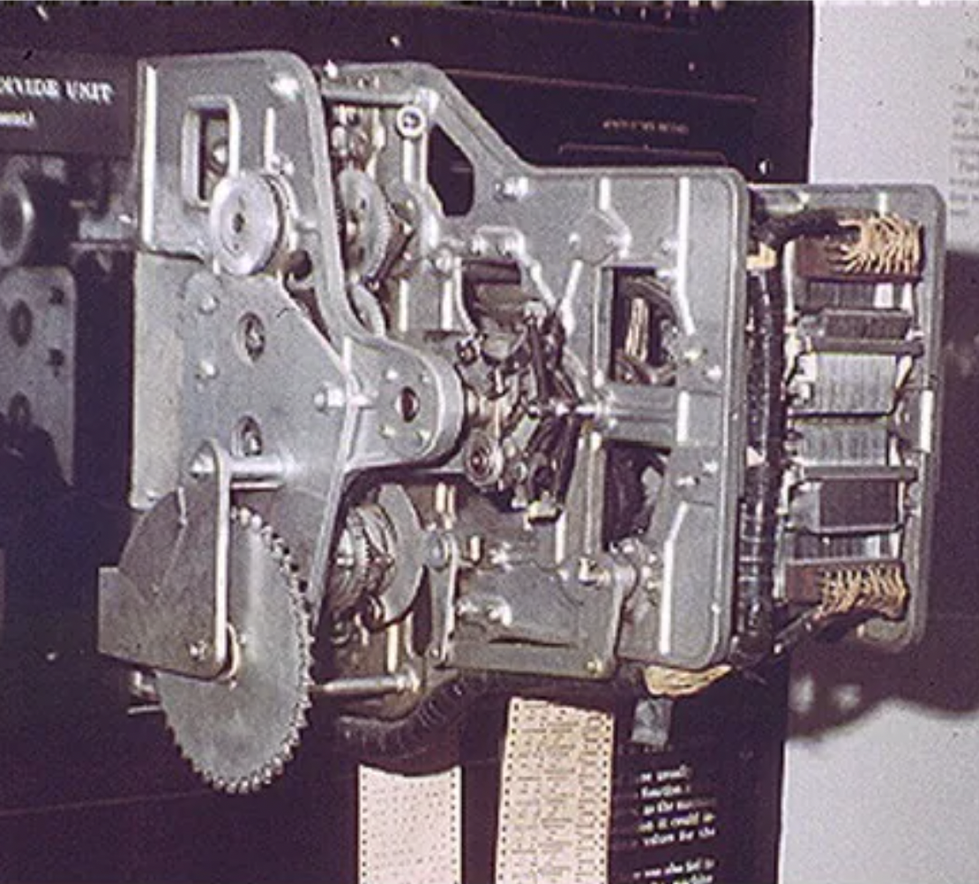
Context - Computing in 1945
Ballistics calculations
Physical switches (before microprocessor)
Paper tape
Simple arithmetic & fixed calculations (before programs)
3 seconds to multiply

Slide 26
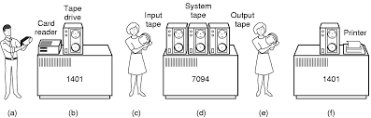
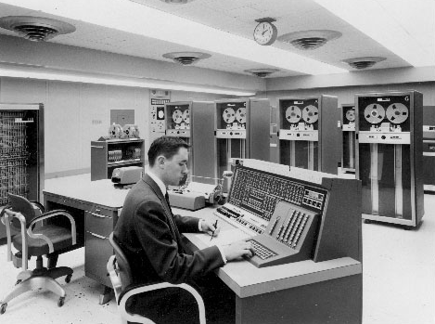
Batch Processing
Computer had one task, performed sequentially
No “interaction” between operator and computer after starting the run
Punch cards, tapes for input
Serial operations

Slide 27
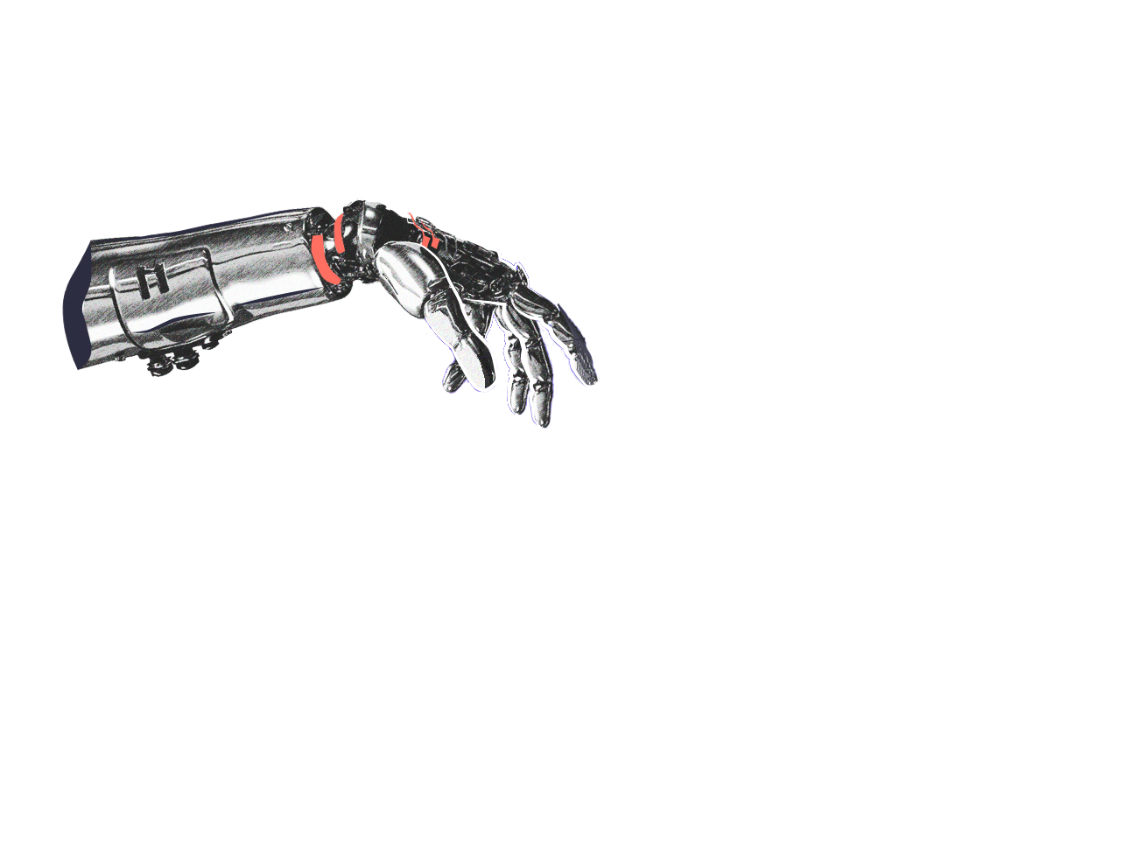
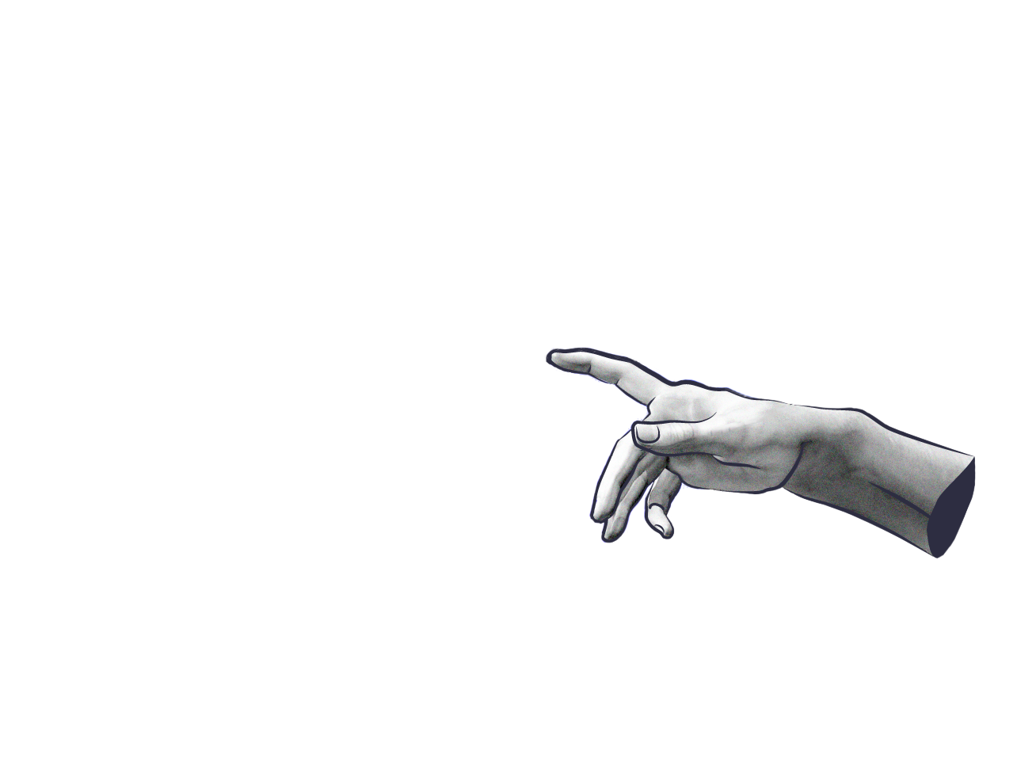
Thanks!
Do you have any questions? chrizmonkey@gmail.com
+84 0937 566 561

